Slide 1
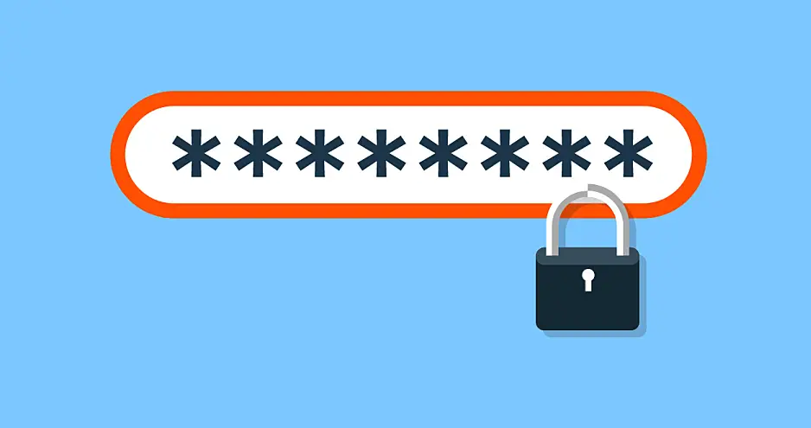
Passwords

Slide 2
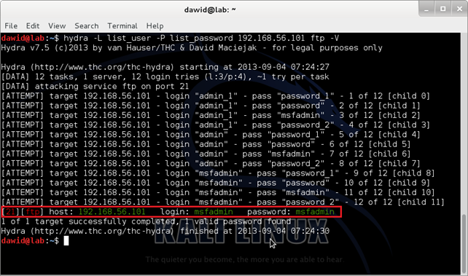
How would someone crack a password
Dictionary attack
Using an enormous list of words
Passwords taken from other hack sites
Brute Force
Guessing every possible combination
The guesses are based on public information taken from social media

Slide 3
What are the most common passwords?

Slide 4
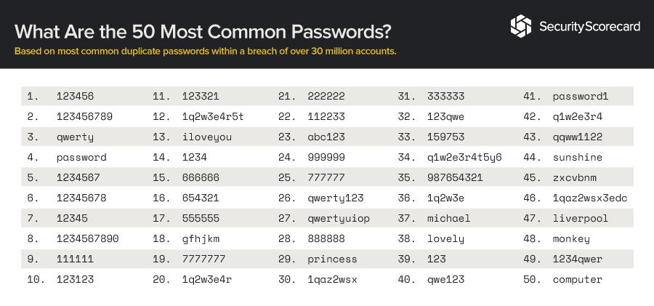
Common passwords you should never use

Slide 5
Make your passwords unique
Tips for a strong password
Favorite Number + Favorite Food + Favorite Character from a book or movie + Symbol
At least 2 uppercase letters, 2 numbers, 1 symbol, and longer than 12 characters
Examples
HarryPotter@Cheeseburger77
FlashPeanut%125

